Slide 1
Design of Low Cost Programmable IoT Platform for Home Automation
Samuel Adedeji

Slide 2
Outline
Introduction
IOT Internet of Things
Nest Thermostat
Objective
Design Requirements
Design Constraints
Design Approach
General System Diagram
Implementations
Tasks !,2,…N

Slide 3
Motivation & Background

Slide 4
Introduction
I am developing a programmable low cost internet of things platform for raspberry pi for home automation applications.
What is Internet of Things (IOT)?
What are some current IOT product available for home automation

Slide 5
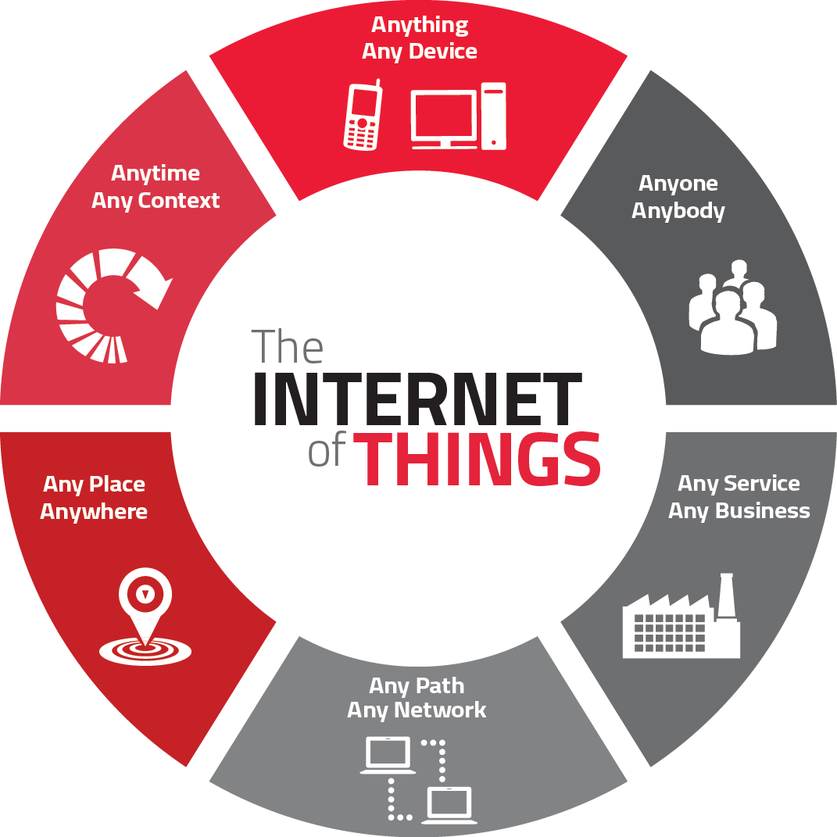
IOT: Internet of Things
Internt of Things (IoT) is the internetworking of physical devices, vehicles, buildings and other objects.
These objects are usually embedded with electronics, software, sensors, actuators, and network connectivity that enable these objects to collect and exchange data.

Slide 6
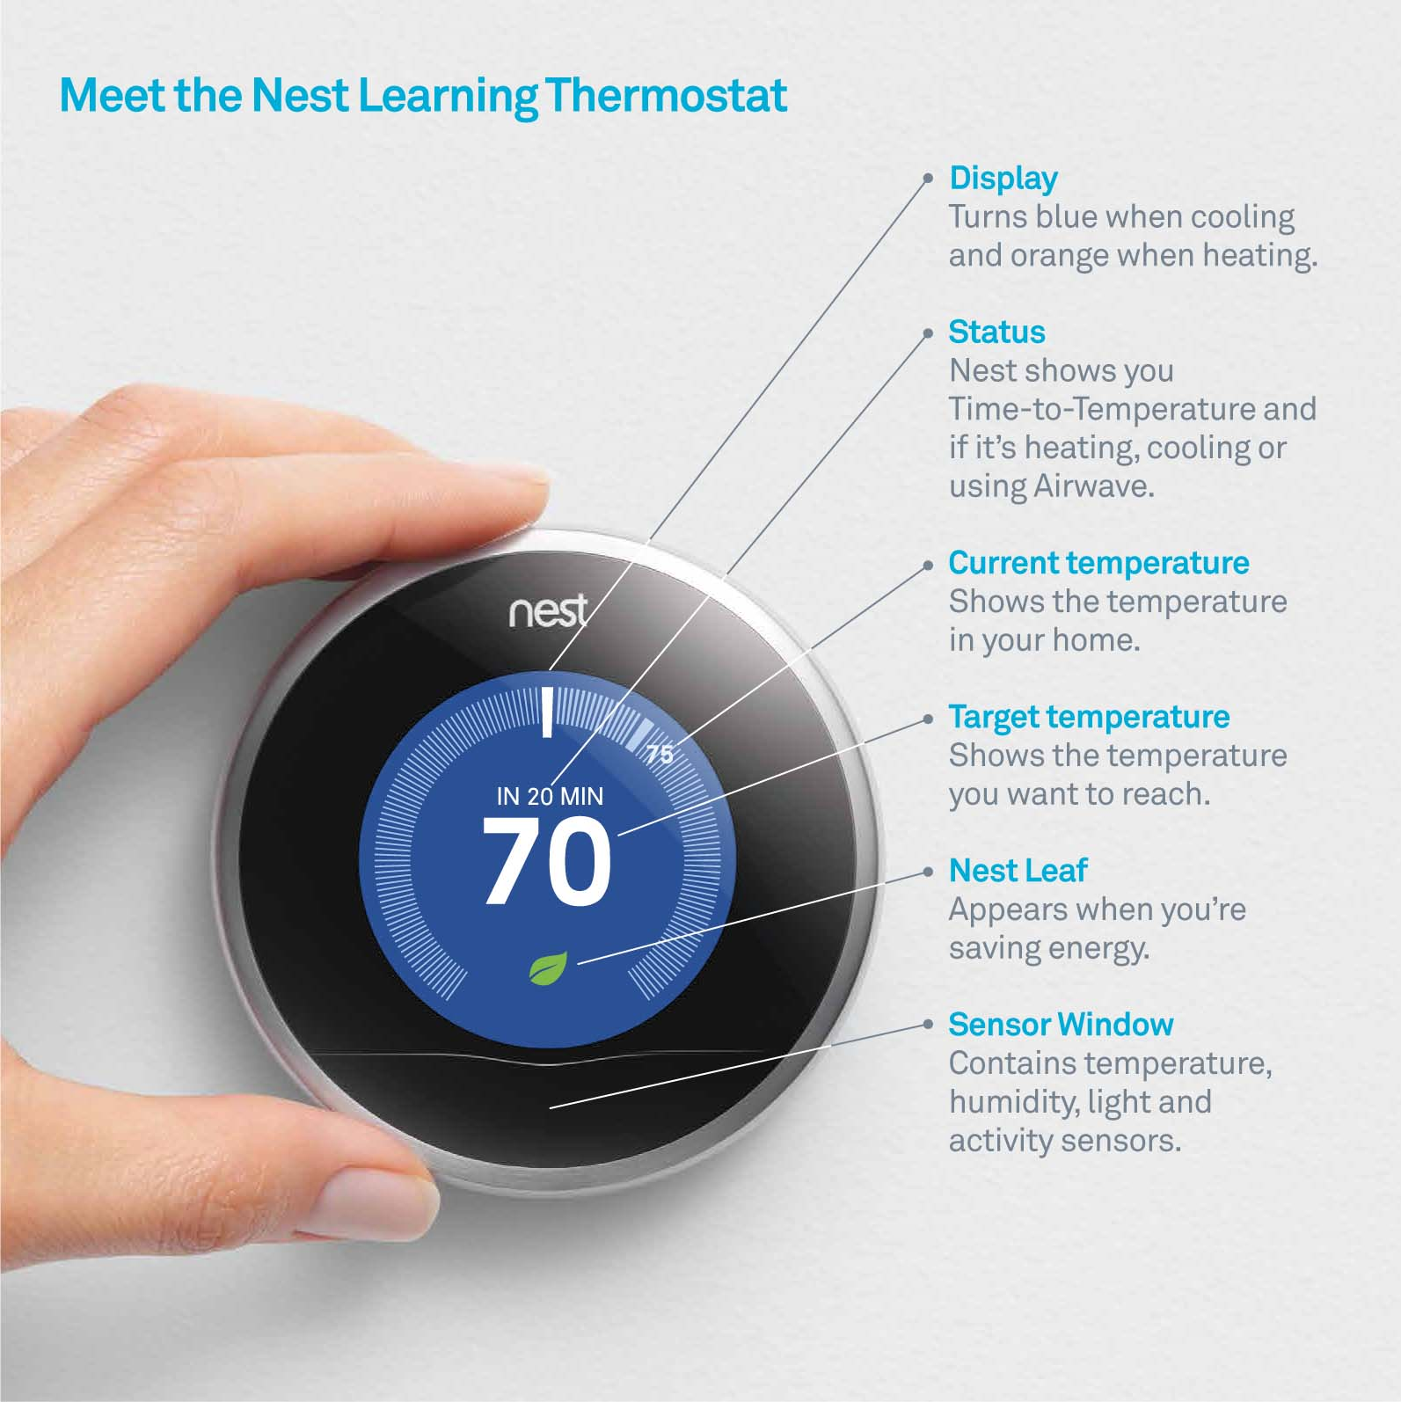
NEST Thermostat
It is a smart thermostat that controls the heat ventilation and air conditioning system (HVAC) system inside a house
Features a new home thermal model that predicts the future temperature inside a home based on weather, current state of the home and HVAC state.
It uses a HVAC control algorithms to optimize comfort and HVAC energy usage.

Slide 7
NEST Thermostat Information
https://nest.com/downloads/press/documents/thermal-model-hvac-white-paper.pdf

Slide 8
Objective
The objective of this project is to design a low cost autonomous IoT platform using the raspberry pi microcomputer. The raspberry pi will be programmed to control multiple physical systems in the house to optimize living conditions.

Slide 9
Design Requirements
The systems needs to be able automatically acquire and display information from the internet.
The system needs to be able to control different home systems based on acquired information
The systems needs a human-machine interface.
- Mobile devices that can access the internet
- Voice recognition system that can access the internet
The system needs to be optimized for the user by performing proper data acquisition and data analysis based on user behavior(s).

Slide 10
Design Constraints
Access to wireless network required
Data acquisition limited by services available online
Online services may charge a fee to access information
Computing capability of Raspberry pi limited
The budget of this project should not exceed $150

Slide 11
Design Approach
Problem identification and research
Specify requirements
Brainstorm, Evaluate and Select Proper Solution
Develop Deliverables/Solutions

Slide 12
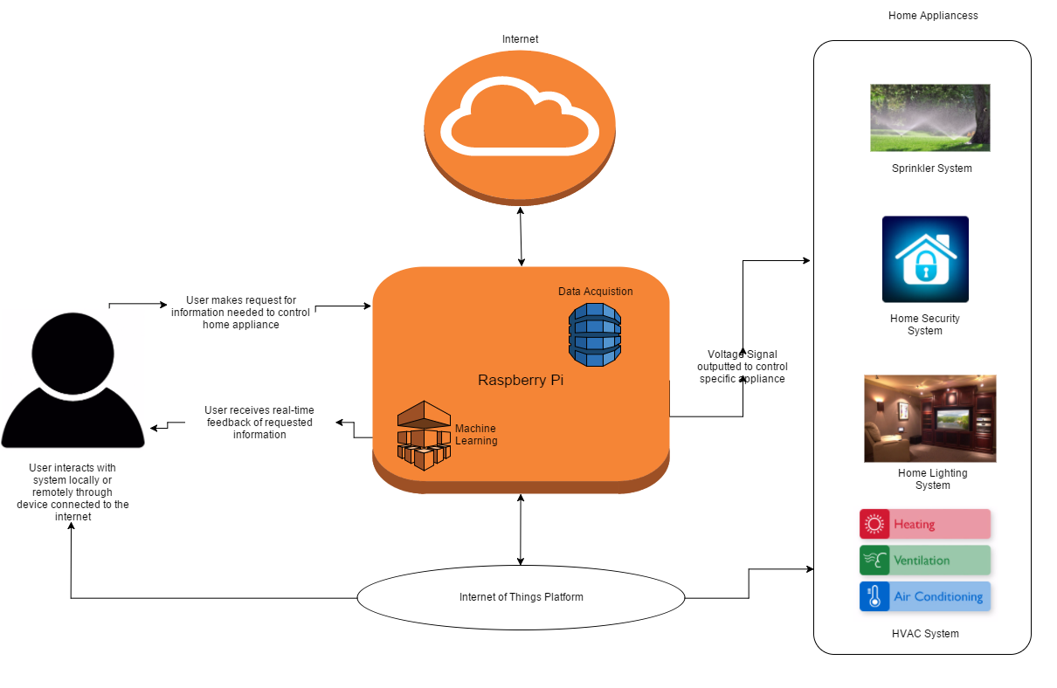
General System Diagram

Slide 13
Implementation
Task 1: Access weather information from the internet using the raspberry Pi
Subtask 1: Use python script to make an HTTP request to Weather Underground API
Subtask 2: Display specific weather information on the 2.8 ‘ TFT LCD touchscreen display to the user
Task 2: Demonstrate the ability to control a system based upon retrieved weather information.
Task 3: Develop a voice-recognition system that has access to the internet and allows control of system.
Subtask 1: Configure usb microphone to record user input
Subtask 2: Create audio keyword to interact with system interface
Subtask 3: Voice based online query that returns answer to user.
Subtask 4: Voice based control.

Slide 14
Task 1: Access Weather Information from Weather Undergound API using the Internet
Create an account with Weather Underground to receive and API key
Create a python script that makes an HTTP request to the Weather Underground API to obtain weather information
After receiving request, Weather API retrieves weathers information and stores and returns the information as Javascript Object Notation (JSON) data to the python script
Python script parse the JSON data dictionary looking for specific weather informations

Slide 15
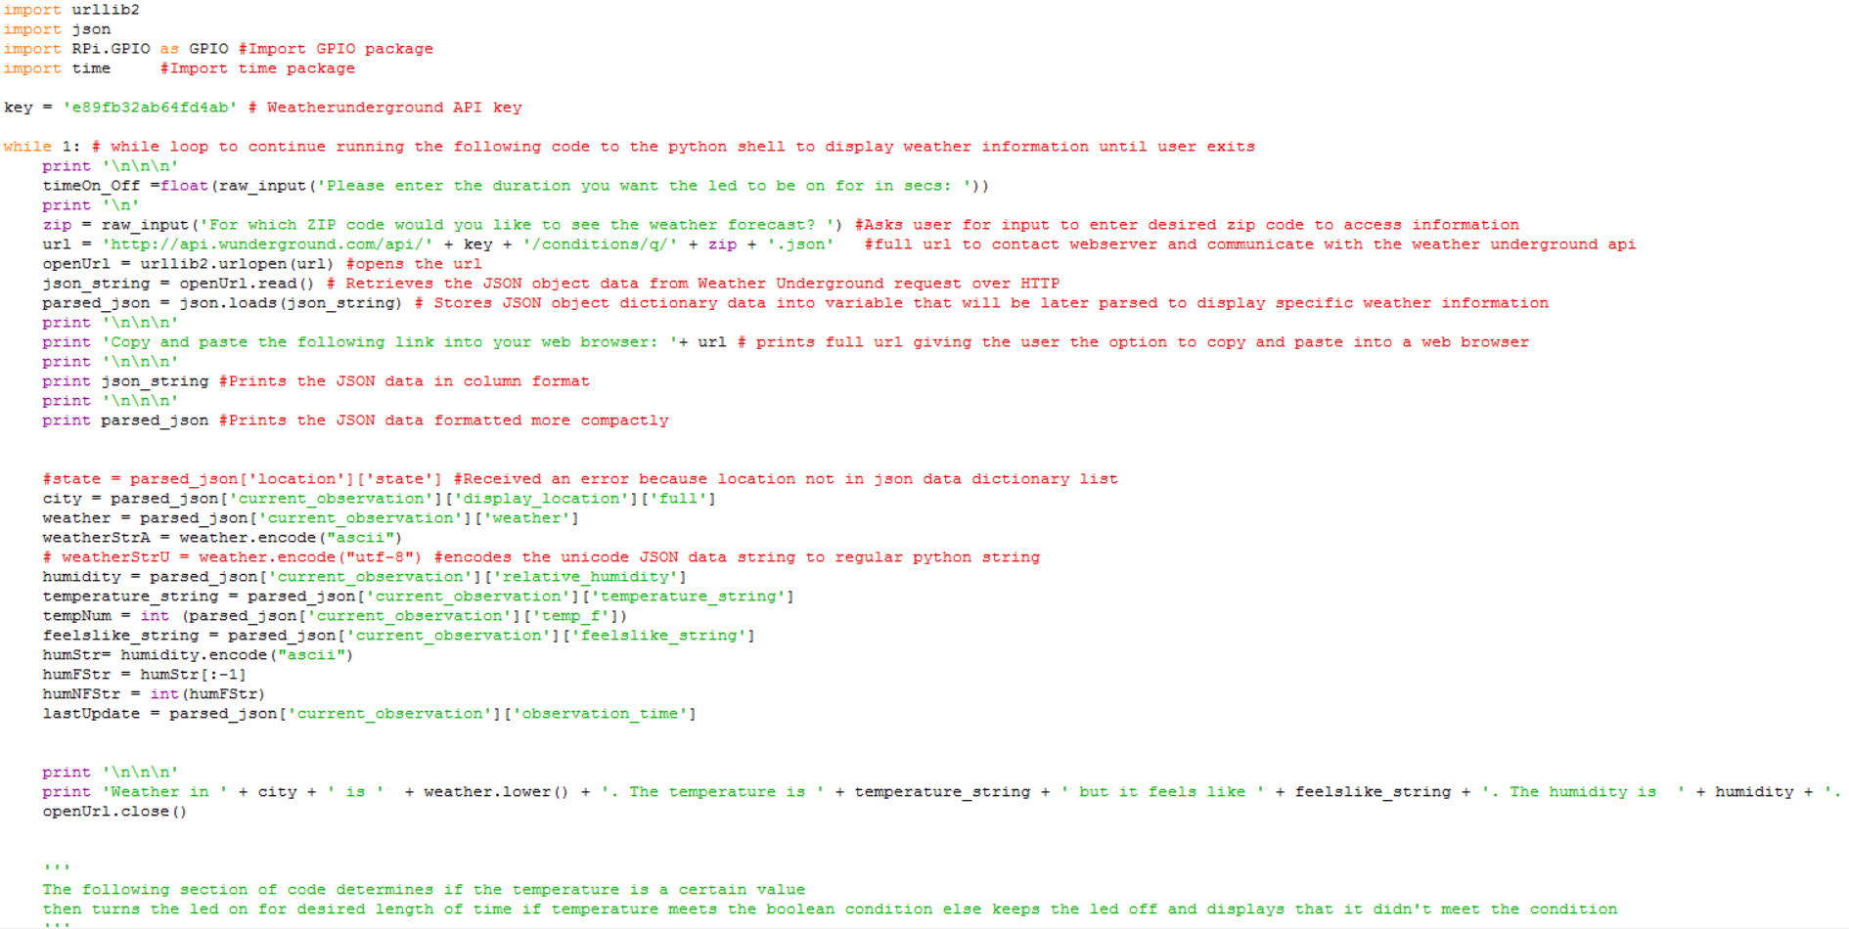
Sub task 1: Python Script used to Access Weather Information from Weather Undergound API using the Internet

Slide 16
Sub task 2: Display Retrieved Weather Information from Weather Undergound API using the Internet back to the User throuch 2.8’’ TFT LCD Touchscreen
Download firmware for touchscreen
Ran into a software iṣsue after firmware download. Kernel module wouldn’t compile on system reboot which led to a frozen Raspberry Pi system

Slide 17
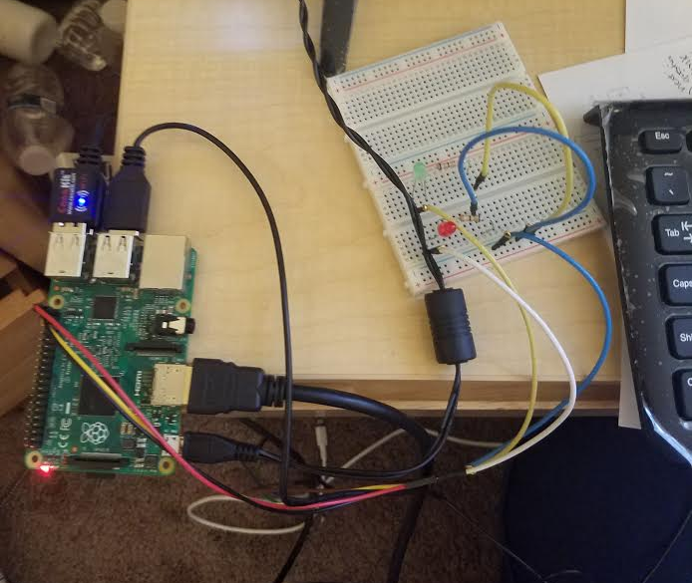
Task 2: Demonstrate the ability to control a system based on weather information retrieval
Setup Led circuit that will be turned on and off based upon specific weather information

Slide 18
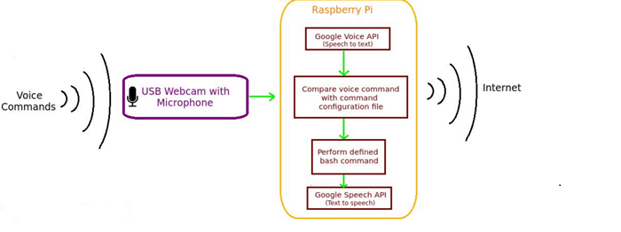
Task 3: Develop a Voice Recognition System that can Access Information via the Internet
System Diagram of Audio Interface Interaction with Raspberry Pi Iot Platform

Slide 19
Task 3: Subtask 1: Configure Microphone to record user input

Slide 20
System Diagram Outlining Audio Interface used to require information online
Accessing the Internet via audio input

Slide 21
Task 4: Demonstrate the ability to control system using audio interface

Slide 22
Budget
-Raspberry Pi 2 $35
-Wireless Adapter $10
-USB Microphone $10
-Breadboard $6
-LED $2
-680 Ohm 5% resistor $1.50
Total $64.5

Slide 23
Conclusion

Slide 24
Future Scope of Project

Slide 25
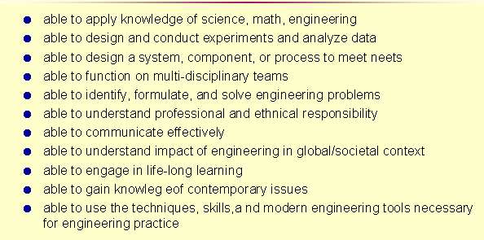
ABET criteriation

Slide 26
Questions?

